Slide 1
The News headline: sarcasm detector
By Aaron schmitz
Cps-493_02

Slide 2

Overview: the what and how
OBJECTIVE:
Design an algorithm that can predict the sarcasticity™ of news headlines
(with acceptable accuracy)
HOW:
By using Hadoop MapReduce
And Java
And a really big dataset with 26,708 entries
The News Headline Sarcasm Detector

Slide 3

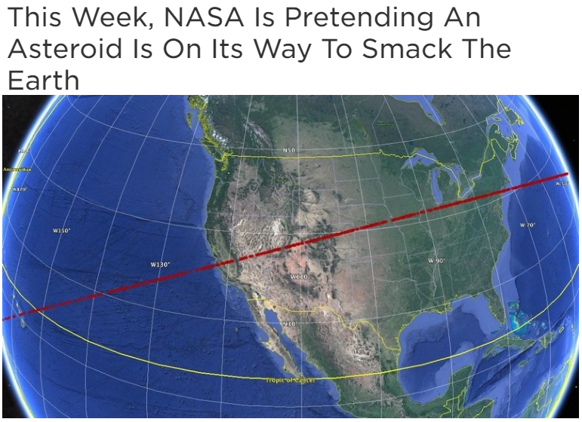
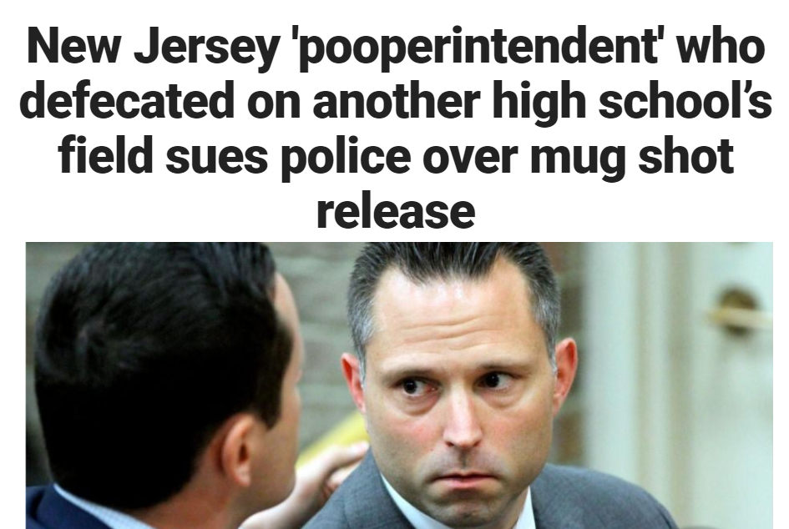

Why?
This is why
ONE of these headlines is a joke—can you guess which one?

Slide 4


Why?
This is why
It was that one

Slide 5




How – The pipeline
Big JSON File
Mapped File
Reduced File
article_link, headline, is_sarcastic
article_link, headline, is_sarcastic
article_link, headline, is_sarcastic
…
is_sarcastic, headline
is_sarcastic, headline
is_sarcastic, headline
…
is_sarcastic, headline, headline, headline…
is_sarcastic, headline, headline, headline…
Hadoop MapReduce

Slide 6
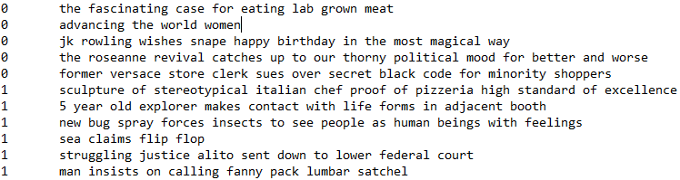
The Pipeline – demonstrated
Original JSON File
Mapped File
Reduced File
Hadoop MapReduce

Slide 7
The sarcasm detector – the main
Utilizes cluster and word count functions
“Serious” and “sarcastic” clusters are formed
Word frequency determines the likeliness of the outcome
Interactive! Allows users to enter their own news headline!
Able to predict sarcasticity™ with about an ~80% accuracy rate
It’s a really useful invention!
It just works!
The Sarcasm Detector

Slide 8

Remember those headlines from before?
The Sarcasm Detector

Slide 9
The code
MapReduce → https://docs.Google.Com/document/d/1nvujz8wphfl7-izc9g6e7opijeh8hmp2por0p0itefs/edit?Usp=sharing
Main → https://docs.Google.Com/document/d/12wwzhw3kvgehnp62kxprdvudnus36bddlnvebm_h_lk/edit?Usp=sharing
java –jar sd.jar score
Let’s try it out in realtime!
The Sarcasm Detector

Slide 10


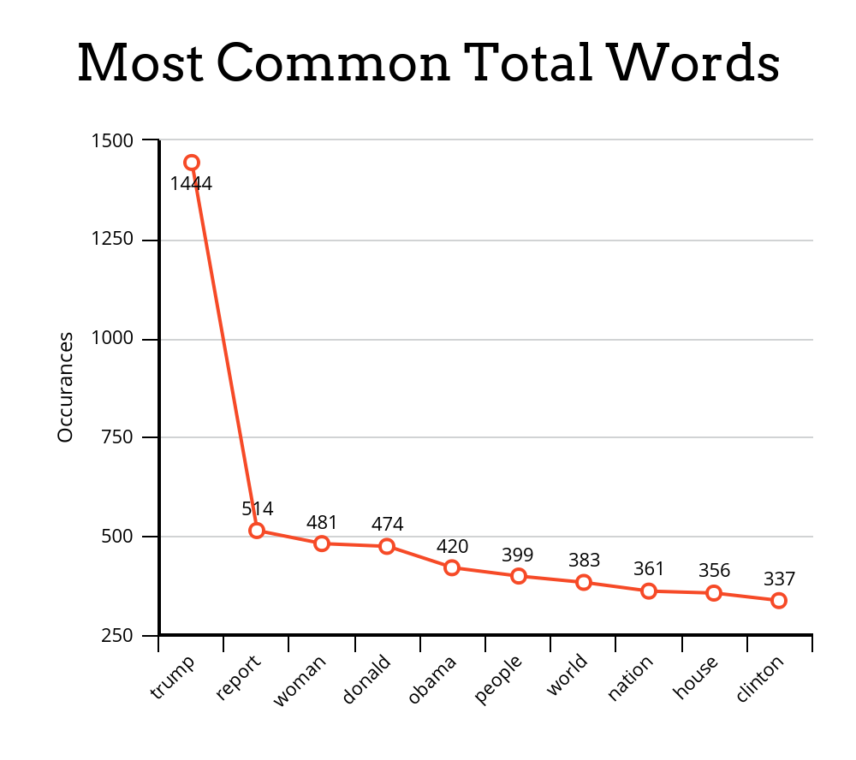
Stats are fun
The Sarcasm Detector

Slide 11
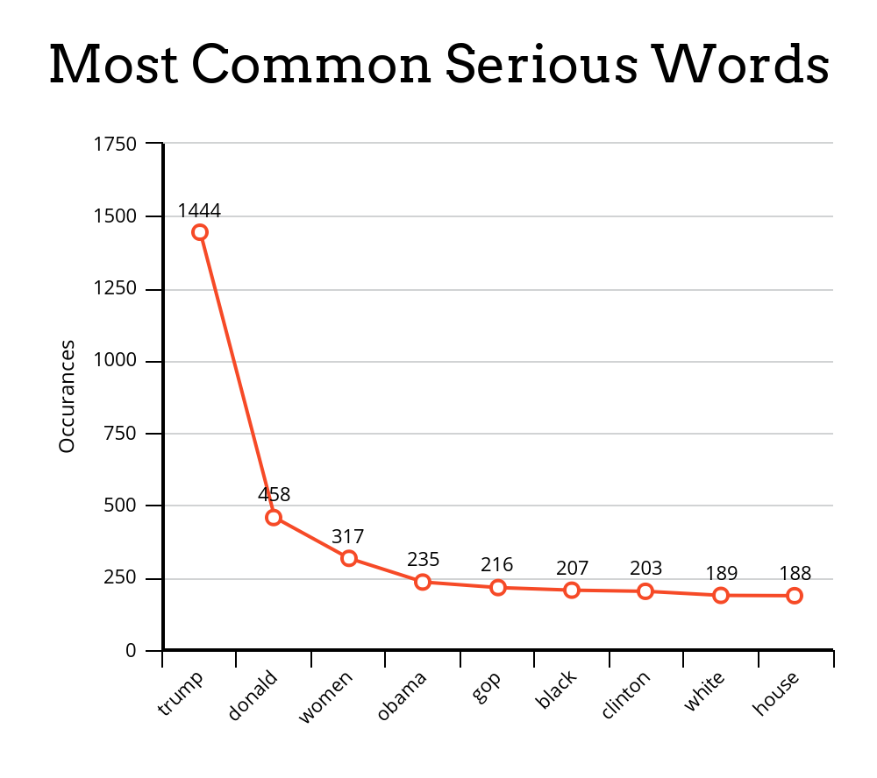
Stats are still fun
The Sarcasm Detector

Slide 12
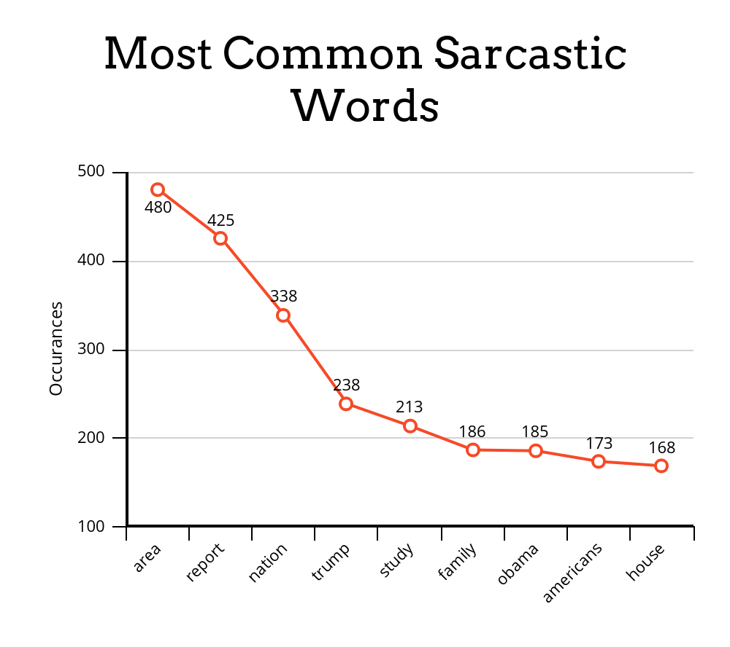
The last of the fun stats
The Sarcasm Detector

Slide 13
end

